Slide 1
HR Employees Attrition
Narratives & Recommendations

Slide 2
Narratives
This analysis explores key drivers of employee satisfaction, performance, and attrition using HR data. By leveraging statistical measures and advanced visualization techniques, we provide actionable insights to improve employee retention, control attrition and organizational efficiency. The findings uncover patterns in performance , satisfaction, and Diversity and highlight risks and opportunities for strategic HR interventions.

Slide 3
Narratives: High Performance and Attrition Risk
High performing employees represent a critical segment of the workforce. Analysis reveals that employees with performance ratings significantly above the average performance rating threshold 3.69 (defined as 1.5 standard deviations beyond the mean), we have 226 High Performers Employees (15% of all employees), 37 of them leaved the company (16% of high performing employees), most of them are from Research and Development (26 high performing Attired employees)& Sales Departments(10 high performing Attired employees)

Slide 4
Narratives: Satisfaction Level
Employee satisfaction is a leading indicator of retention. Our findings show that The likelihood of attrition for employees with low satisfaction compared to others are 1.76 times more likely to leave the organization. Departments with high workloads, Low work life balance, or limited career growth opportunities are particularly impacted, indicating the need for targeted engagement strategies.

Slide 5
Narratives: Gender Diversity and Inclusion
An analysis of gender-based metrics highlights disparities in satisfaction and performance. For Satisfaction: Female employees in sales representative shows Likelihood to Attrite equal 1.3 times than others with High Satisfaction (0.88 for Males) and laboratory technician shows Likelihood to Attrite equal 3.3 times than others with High Satisfaction (1.69 for Males), For Performance: High performance Female employees have Likelihood to Attrite equal 2.64 with 16% of Actual Attrition Rate so we can find that some roles report lower satisfaction levels despite demonstrating comparable performance to their male counterparts. This suggests potential gaps in equity and inclusivity, which could hinder retention and employee morale if not addressed.

Slide 6
Narratives: Departmental Insights
When Identifying % of attrition based on each Departments we will find that Sales, Human Resources and Research & Development have 21%, 19%, and 14% of attrition respectively. and when comparing high performers with others we will find that for some Job roles we have average of Income for high performers on these job roles that are lower the average income for the other employees with normal and low performance such as (Sales Executive – Research Scientist – Laboratory Technician – Human Resources ). And when comparing the relative risk for these job roles with others we will find that they have the highest Likelihood to Attrite because of Low satisfactions with (2.34 times – 1.78 times – 1.94 times – 1.47 times)

Slide 7
Narratives: Identifying Outliers
Outlier detection provides valuable insights into employee dynamics. Using statistical thresholds to calculate High Performance Employees, we identified employees who stand out in terms Average Income, Years at Company, total working years, years since last promotion, and years in current role by calculating the Z-Score and if it’s higher than 3 so it will be identified as outlier.

Slide 8
Narratives: Attrition Risk Score
The Attrition Risk Score is a proactive approach that integrates key metrics, including satisfaction, performance, and compensation (Monthly Income), to identify employees at risk of leaving (Attrition). Employees with high Attrition Risk scores represent an actionable subset for HR interventions. This tool enables proactive retention strategies by prioritizing high-impact individuals. (1 - (JobSatisfaction + EnvSatisfaction) / 10) * PerformanceRating * 100 / MonthlyIncome Higher satisfaction reduces risk score
Low income and high performance increase the likelihood of attrition

Slide 9
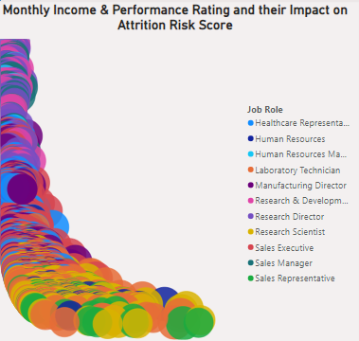
Narratives: Attrition Risk Score
we found that there is a correlation between Attrition Risk Score and Monthly Income (Salary) that as the Monthly Income Increase the Attrition Risk Score decrease and vise versa

Slide 10
Narratives: Expected Voluntary Attrition
Sometimes employees leave the company by their own to find another job and upskill and sometimes they leave because of Layoffs or low performance, we made an assumption that if the attrite employee have satisfaction less than or equal 2 or have performance greater than 3 so he might have Voluntary Attrition other than it will be Involuntary Attrition. If we focus on Voluntary Attrition for high performers we will find that most of them have an average salary that is lower than the average salary for other employees such as sales representatives, sales executives and research scientists (that confirms that main factor for attrition for high performers is that they take monthly income lower than the income for others that have low performance)

Slide 11
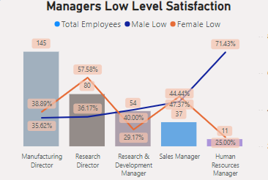
Narratives: Managerial Satisfaction
When focusing on managerial level satisfaction, you can find that most of them have high percentage of low satisfaction and a high relative risk, such as for female sales manager and female Manufacturing Directors they have a high relative risk comparing to others with high satisfaction and males in the two positions, and for female Research Director they have 57.58% of low satisfaction, also for Male Human Resource Managers they have 71.43% of low satisfaction that give us an indication that the satisfaction on this organization as a whole is not good for both officers and top managers

Slide 12
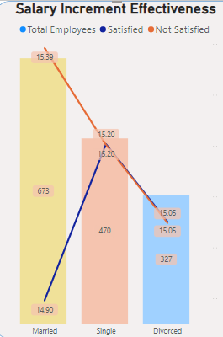
Narratives: Salary Increment Effectiveness and Employees’ Marital Status
Observation: Employees who Married have High Not Satisfied Rate for the salary hike although they have a high salary hike than others, that is an Important indication that the salary hike is not a cause for attrition for married employees.

Slide 13
Narratives: Key Insights Summary
The analysis reveals that high performance, low satisfaction, and pay inequities are critical factors driving attrition. Gender disparities in satisfaction and challenges in workload balance highlight the need for a comprehensive approach to retention. Addressing these areas offers significant opportunities to enhance employee satisfaction and long-term organizational success.

Slide 14
Recommendations
Recommendations for Improving Employee Retention, Performance and Reduce Attrition. Based on the findings and analysis, the following recommendations are presented to address key areas of concern and opportunities for organizational improvement. Each recommendation is aligned with the insights derived from the data.

Slide 15
Recommendations: Retention of High Performers
Observation: High-performing employees face higher attrition risks, particularly in departments with lower compensation or recognition. Recommendations:
Enhance Incentives: Implement tailored salary adjustments and Stock Options for High Performing Employees specially with those who are in non career development roles such as sales representatives.

Slide 16
Recommendations: Advancing Gender Diversity and Inclusion
Observation: Female employees in sales and Laboratory technician roles report lower Environment and Job satisfaction despite similar performance levels. Recommendations:
Satisfactions: Implement tailored work and job environment that is suitable for females
Career Development: Provide career development trainings.

Slide 17
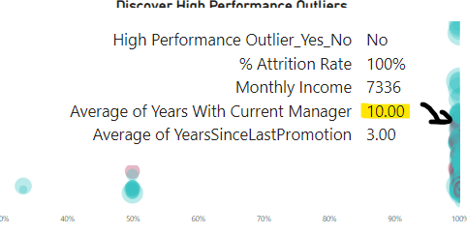
Recommendations: Utilizing Outlier Analysis for Attrition Risk Management
Observation: Outliers in performance and satisfaction metrics provide critical insights into potential retention risks. Recommendations:
Outlier Early Warnings: most people who attrite are working with the same manager for more than 5 years, and take more than 7000 income that’s may indicate that they lose the ability to develop under his supervision so they leaved the company, or may they want to leave the comfort zone and find a new challenge, so we should improve ability and develop mechanism for those employees to reduce the Risk of Attrition

Slide 18
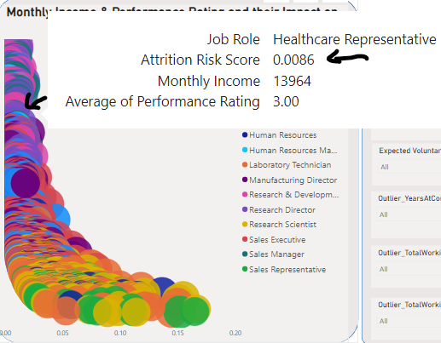
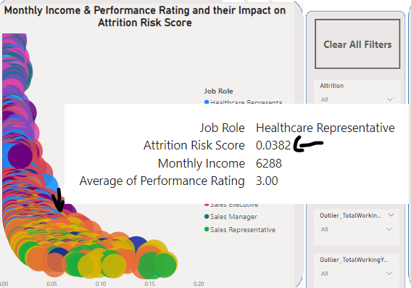
Recommendations: Utilizing Outlier Analysis for Attrition Risk Management
Observation: for the same position, you can find employees have the same performance rating and huge difference between their Monthly Income Salary so that leads to increase the Attrition Risk Score and create diversity between employees Recommendations:
Outlier Early Warnings: develop incentive compensations based on the performance rating for employees and rescale the Monthly salary to be based on job level, experience, and performance

Slide 19
Recommendations: Salary Increment Effectiveness, Relative Risk and Employees’ Marital Status
Observation: Employees who Divorced have the lowest Not Satisfied Rate for the salary hike although they have a low salary hike than others, that is an Important indication that the salary hike is not a cause for attrition for married employees, comparing to relative risk, the divorced employees have the highest relative risk (2.31 time than high satisfaction employees) Recommendations: provide a good and suitable environment for them to decrease the relative risk

Slide 20
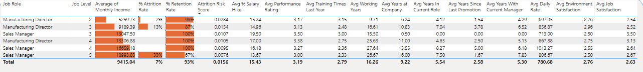
Recommendations: Gender-Based Retention Strategies
Observation: There is a Low Satisfaction from Female Leaders and Managers in the Research & Development and Sales Departments.
Observations: female sales manager (1.11 times) and female Manufacturing Directors (4.71 times) they have a high relative risk comparing to others with high satisfaction and males Recommendations: 1) Review the working culture in this department and most of females specially the top management have satisfaction on it comparing with other departments

Slide 21
Best Regards

Slide 22


Microsoft Power BI

